Slide 1

ONLINE GROCERY STORE
DHRUVI HARIA 21204012
DISHA BENDALE 21204011
SNEHI RATANI 20104035
Project Guide
Prof. Sonal Jain

Slide 2
Contents
Introduction
Objectives
Scope
Features / Functionality
Project Outcomes
Technology Stack
Flow Chart(if applicable)

Slide 3
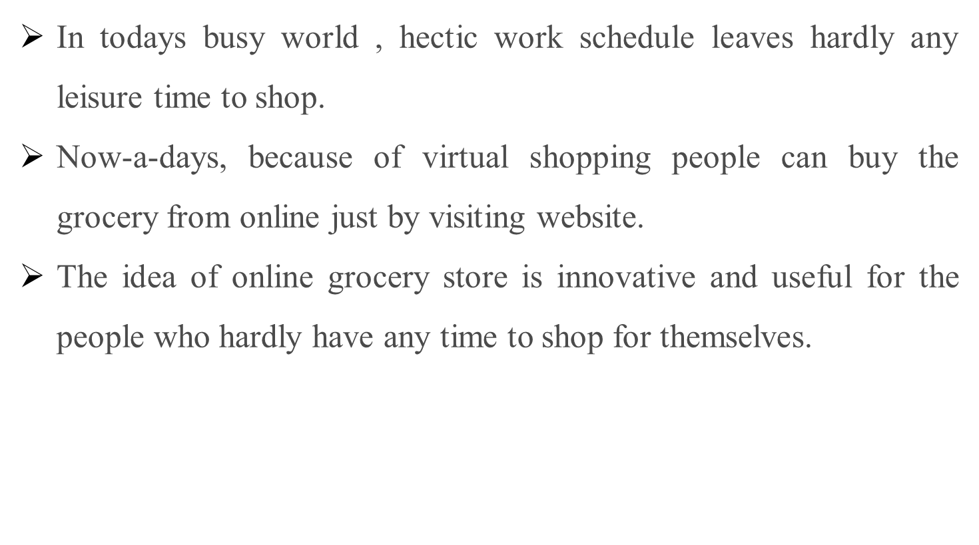
1. Introduction

Slide 4
2. Objectives
To provide a user-friendly interface with dynamic features.
To provide user options to make their account and order the goods of their needs.
To provide admin all the data related to orders, stocks, and customers.
To provide buyer a option to apply for coupon code.

Slide 5
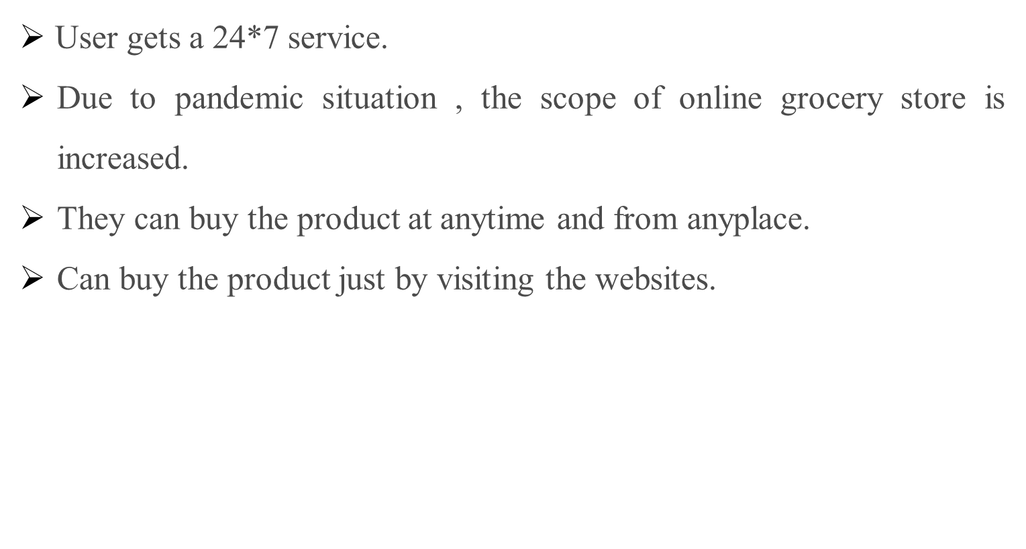
3. Scope

Slide 6
4. Feature /Functionality
Product categorization
Manage product quantity and quality
Coupon code
User-friendly interface
Popular products
Stock management

Slide 7
5. Outcome of Project
User can sign-in and sign-out.
Admin can check the stock details, user details and can also update or add the products.
After login user can see the product page in which they can add the product to cart which they want to purchase.
User can also update their profile details.

Slide 8
6. Technology Stack
Frontend
Python
    Version - 3.10.2
Django
    Version – 4.0.3
  Backend
    db - SQlite

Slide 9
7. Flow Chart
ONLINE
GROCERY
STORE
Admin Login
User Login
Sign in/sign up page
User details/history
Stock Update
Product page GUI-
All the items with the option to add them to cart and my cart and log out buttons at the top.
My cart shows the summary of the products added to the cart, user can add their address and no. and provide the payment option.

Slide 10
Thank You...!!

